Slide 1
Database Management Systems CATERING RESERVING AND ORDERING SYSTEM
By
B.JAYA SAI REDDY 2110030091
J.SAI VAMSHI 2110030296
ROHITH REDDY 2110030201
G.SRIRAG 2110039472
Under the guidance of
Mr. Sumit Hazra

Slide 2
Problem statement and domain
Food is a basic need which people consume every day. Aside, from homemade food, a lot of people are also fond of eating foods from restaurants. People usually go to their favorite restaurants to dine but this method is not convenient at all times due to physical barriers and time constraints. Purchasing foods outside home is hard for busy people and for those who are too lazy to go out. For catering services, the manual process is to reserve for it personally. Those who wish to avail for catering services would personally book reservation which requires a lot of effort and time. It is what the people and restaurant owner’s need is a platform where food ordering transaction is convenient and easy.

Slide 3
Existing solutions/ Naïve solutions
The proposed solution for the above mentioned problems is the food order and catering services system which will make food transaction go online. The system will be used by two sides, the customers and the restaurant personnel who is in-charge for the customer’s order. The customer can browse and order for food online. Reservation and booking of catering services is also available in the system. The system is easy to use and convenient for customers. This will improve the existing manual system of ordering for food.

Slide 4
Data Structures needed
Database is responsible for storing the data in well-defined manner.
The required tools for this project are:
MySQL
StarUML
Pycharm
PythonTkinter

Slide 5
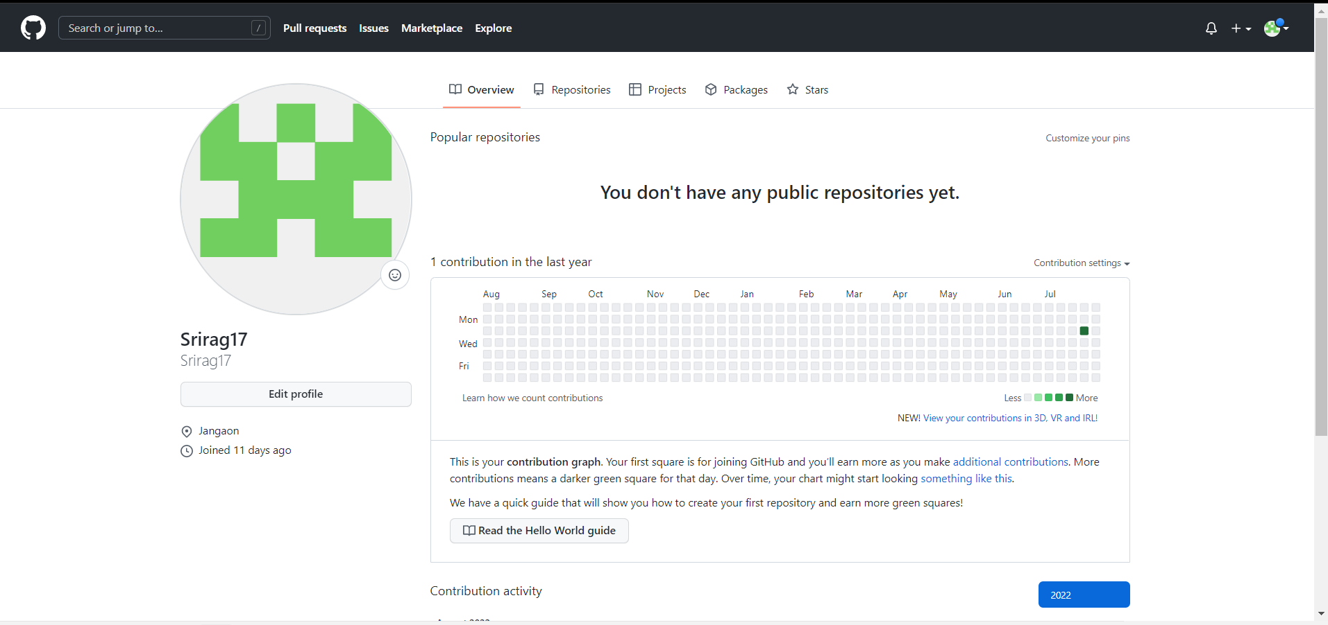
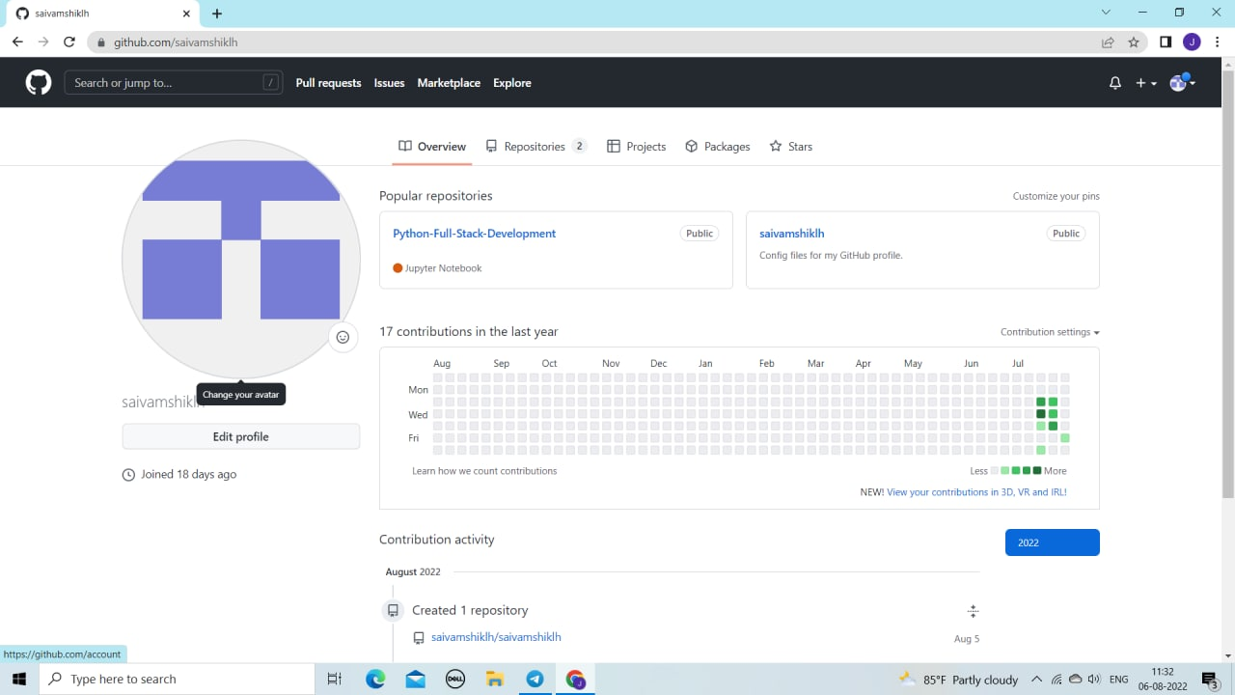
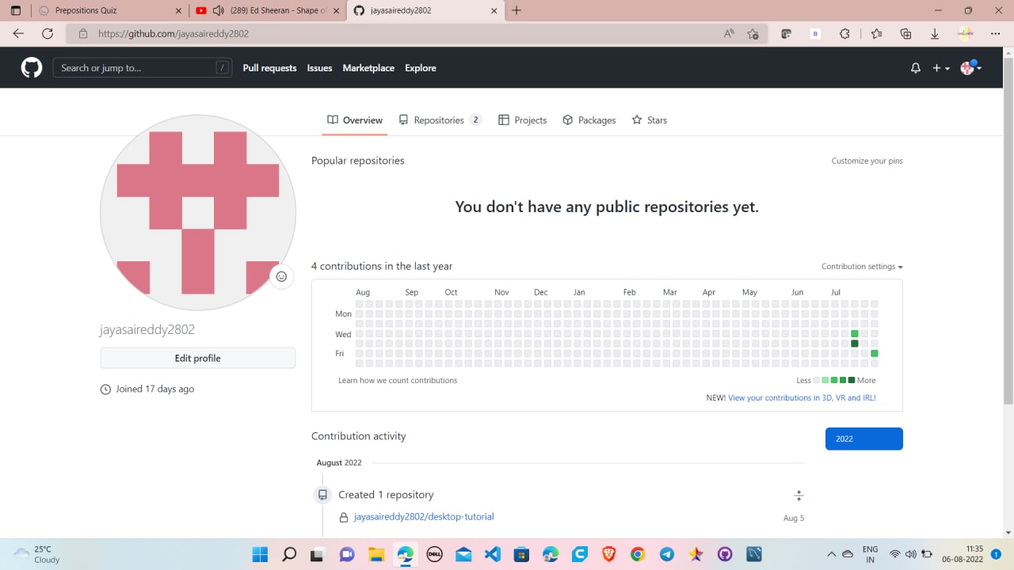
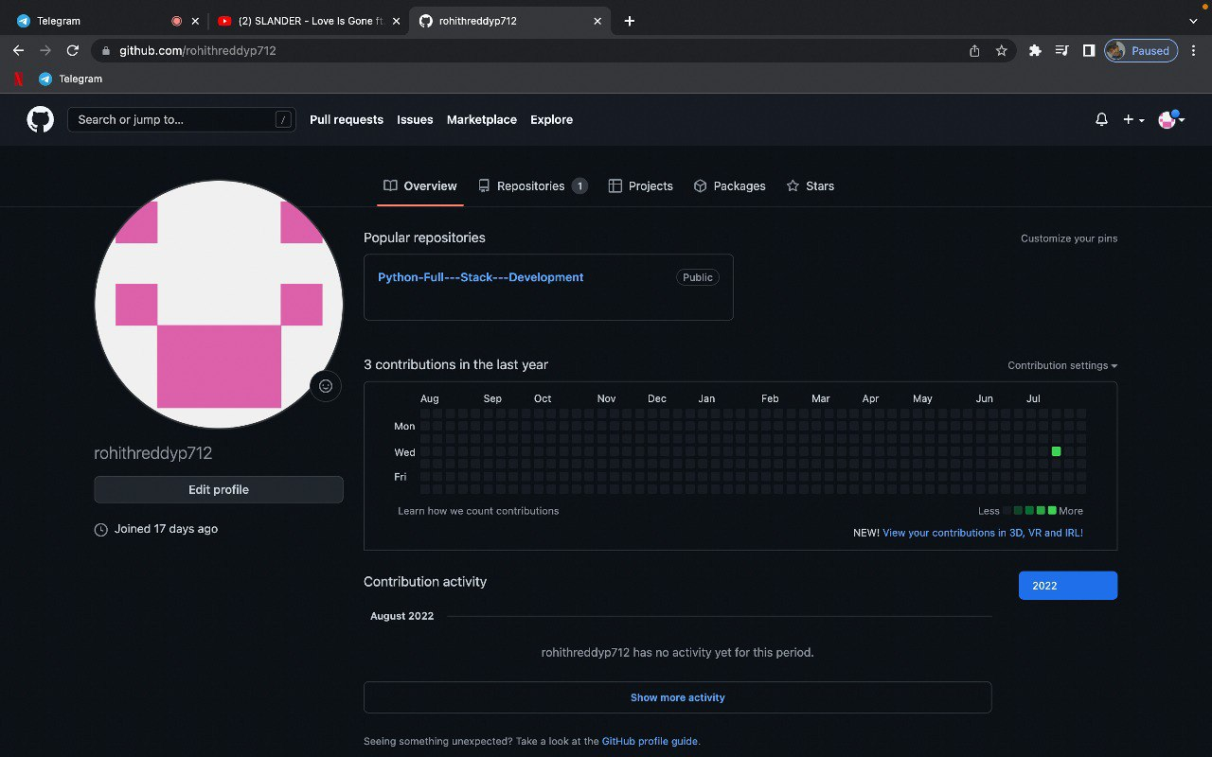
Github setup

Slide 6
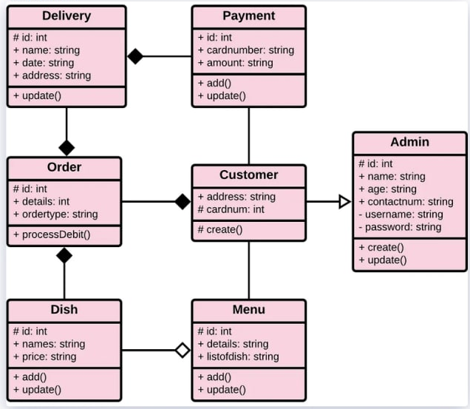
CLASS DIAGRAM

Slide 7
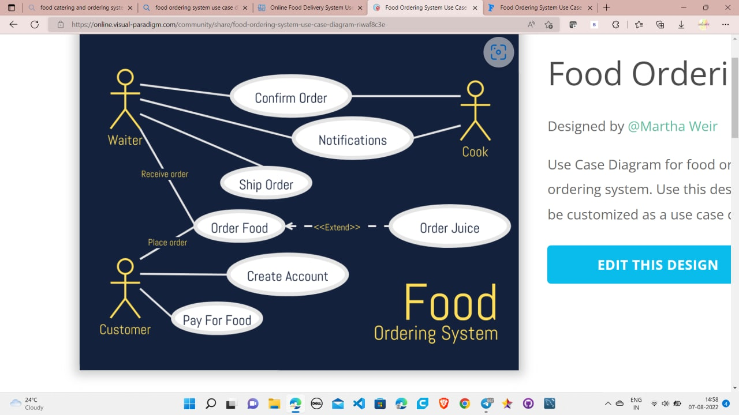
USE CASE DIAGRAM

Slide 8
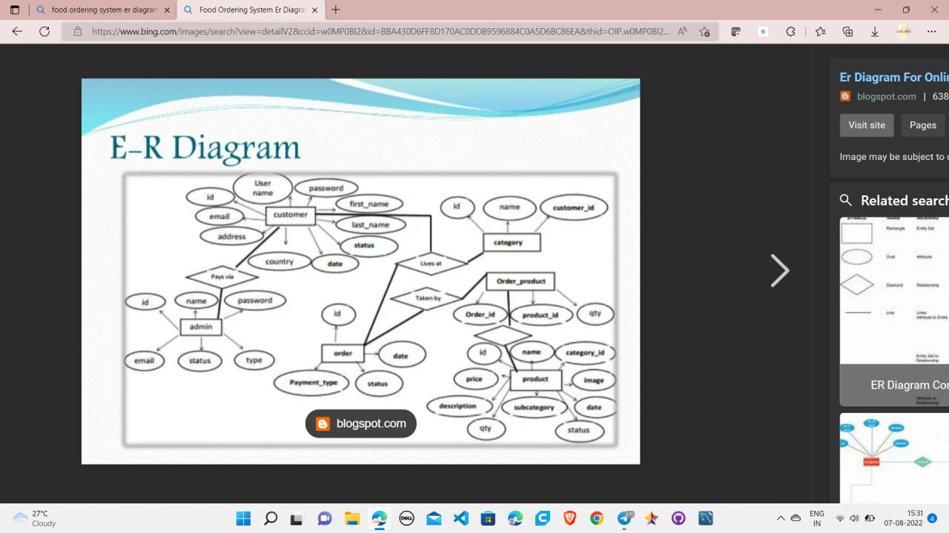
ER DIGRAM

Slide 9
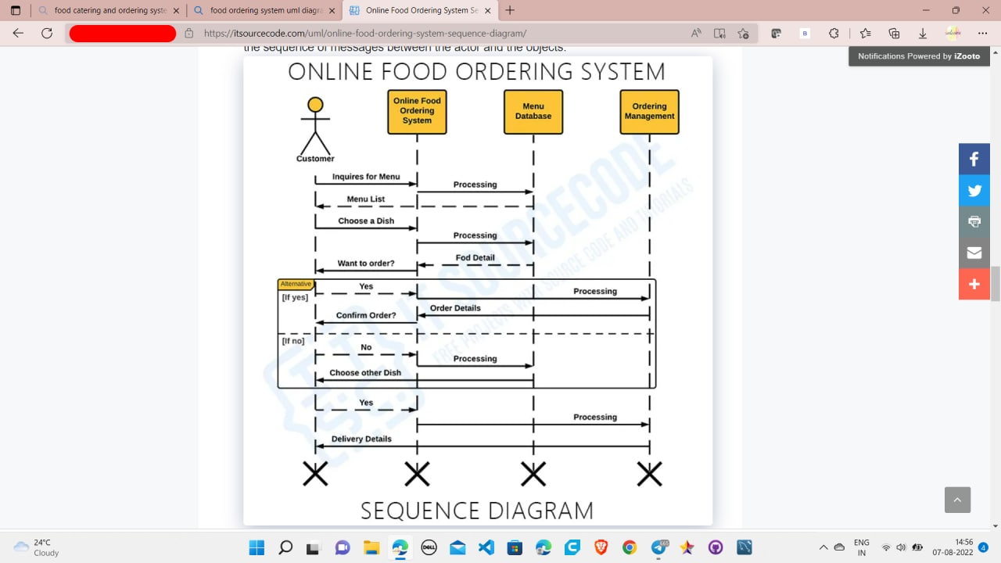
SEQUENCE DIAGRAM

Slide 10
Division of work among the group members
B.JAYA SAI REDDY 2110030091 – prepared class diagram
J.SAI VAMSHI 2110030296 – Prepared PPT
ROHITH REDDY 2110030201 – ER diagram
G.SRIRAG 2110039472 – Gathered information about project

Slide 11


